Slide 1
Nature’s priest

Slide 2
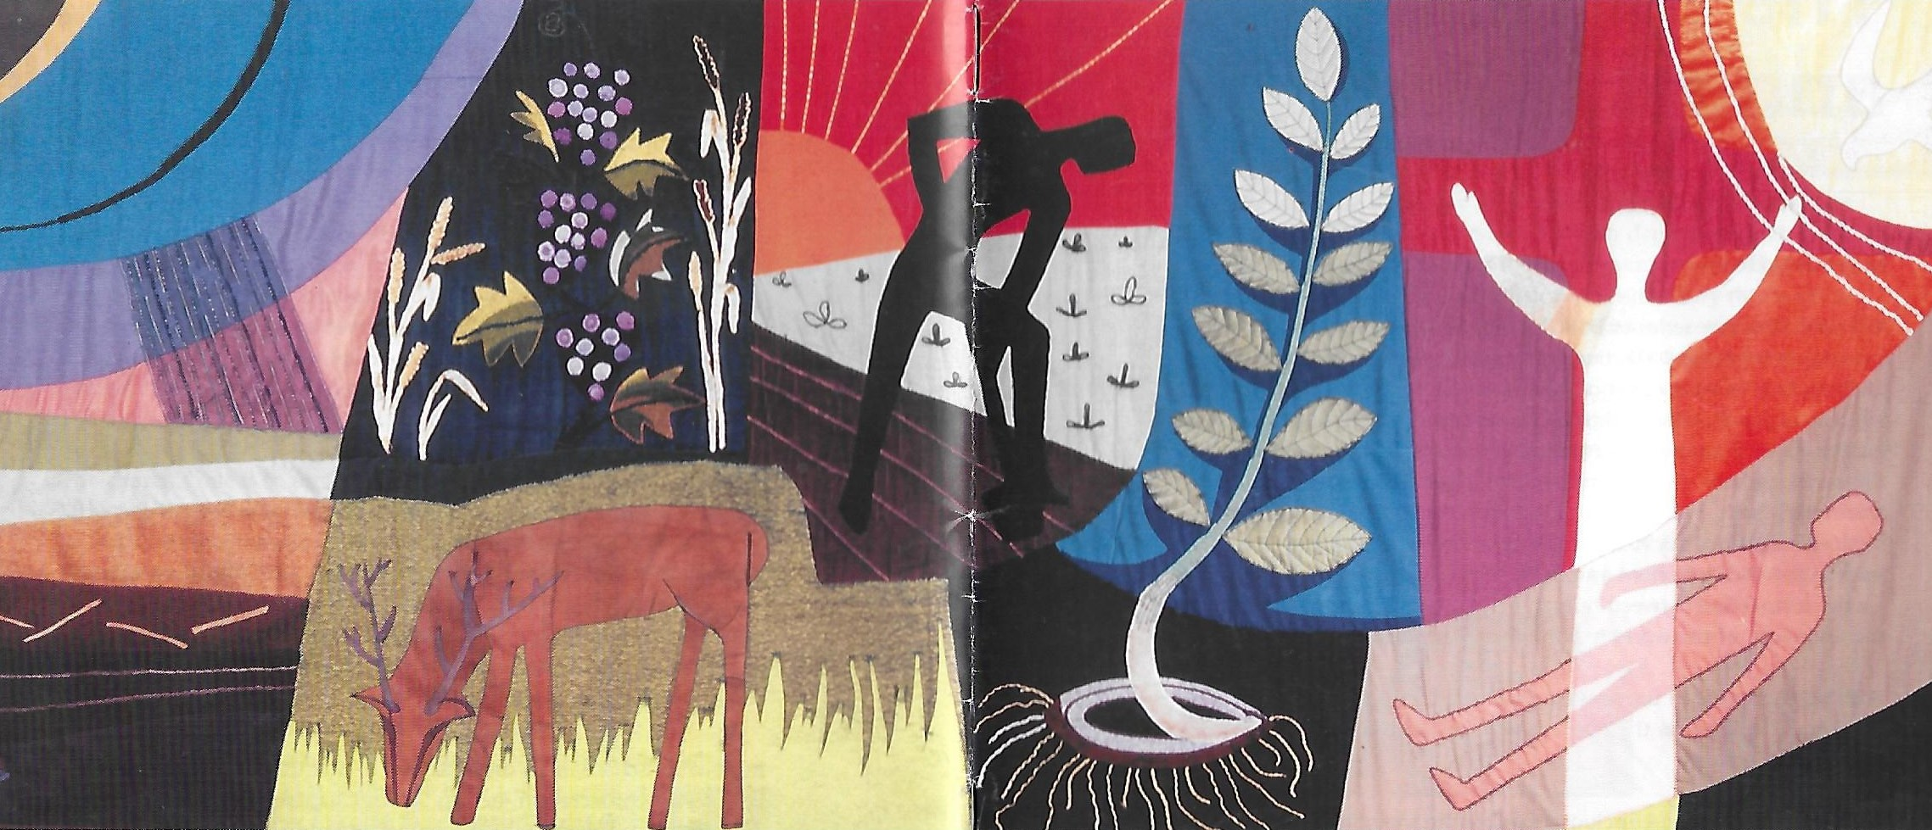

Slide 3
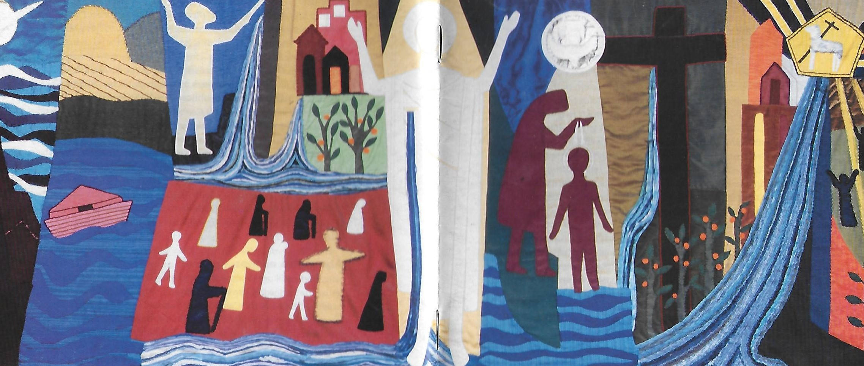

Slide 4
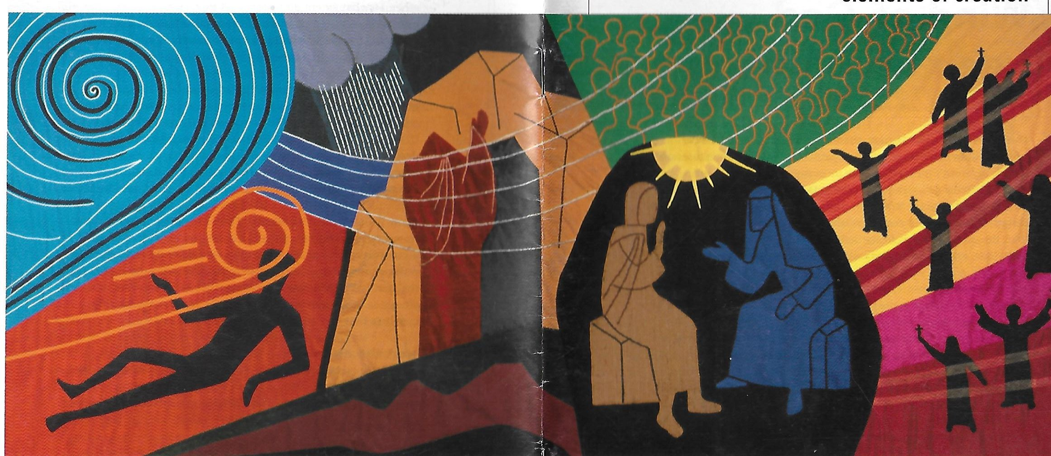

Slide 5
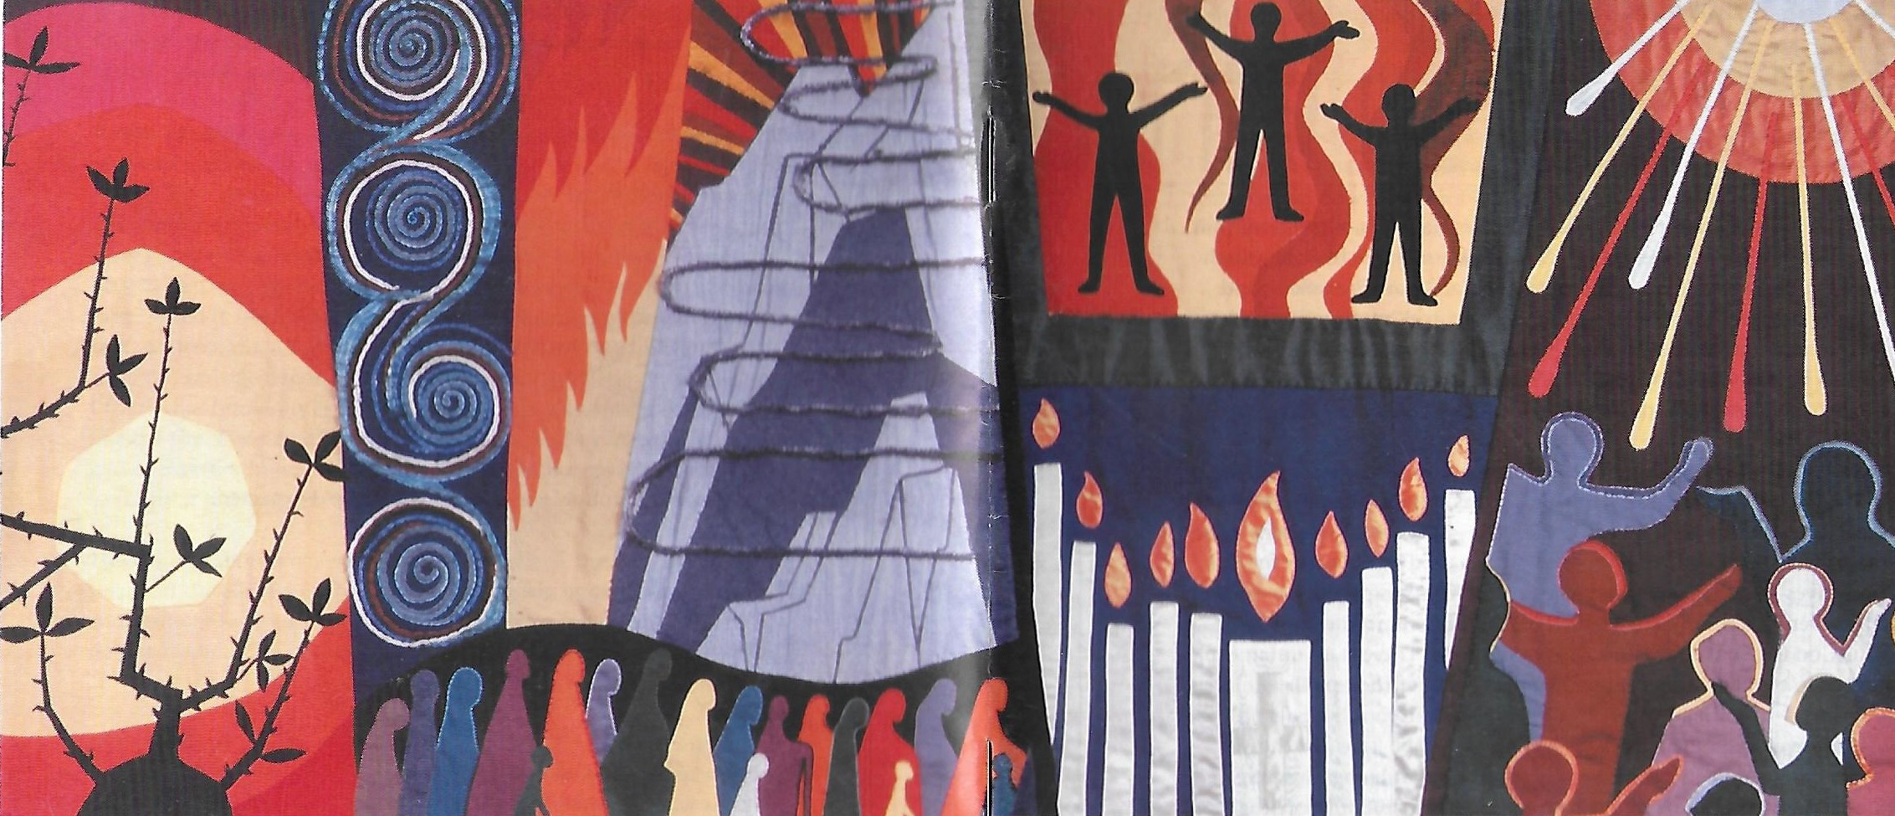

Slide 6
‘To a surprising degree, exegetical discussion of Christianity’s relationship to environmental ethics and practice has been confined within a narrow band of Old Testament texts. In fact the scriptural site of this debate rarely extends beyond the creation stories and ‘dominion over the earth’ language clustered in those first two chapters of Genesis. Even fewer New Testament passages have attracted serious reflection on the topic.’
(John Gatta, The Transfiguration of Christ and Creation)

Slide 7
The Christian account of creation is set within the context of the economy of salvation. There is thus a presupposition of interconnectedness between creation, redemption and consummation, which places a theological interdiction against seeing creation as an isolated action or event, complete in itself. In particular, the Christian concept of creation is linked to that of incarnation. (A.McGrath, The Open Secret: A New Wisdom for Natural Theology)

Slide 8
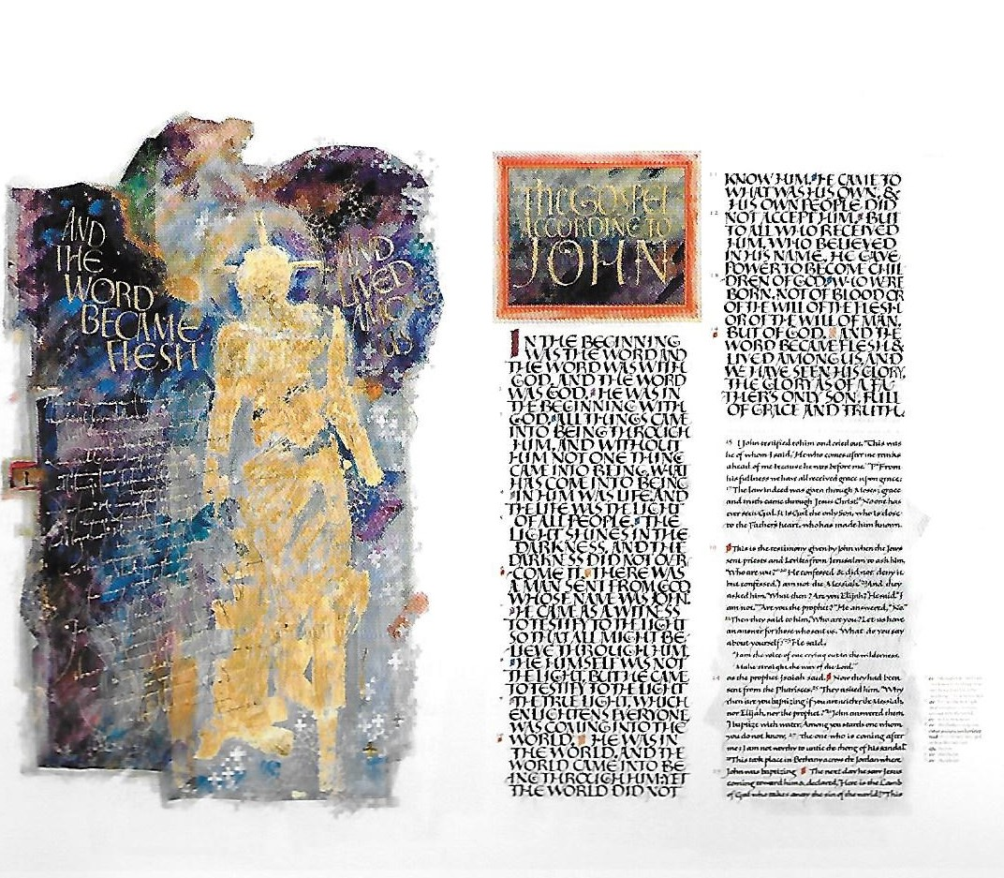

Slide 9
John 1
Overt links to creation story of Genesis 1
Life and ministry of Jesus inaugurates a ‘new creation’ (see Baelz hymn)
What this passage says of the ‘Word’ could be (and was) said of ‘wisdom’ by other Jewish and Christian writers
For Christians by the end of the first century Jesus Christ was identified as both the Word and the Wisdom of God.
Christ is the agent of creation, and the fact of his ‘incarnation’ (becoming flesh) means that he becomes the ultimate ‘sacrament’ – the person and place where God ‘shines through’ in the material and physical world
This is what is implied by the use of the word ‘glory’. (compare: Hebrews 1.3 ‘³He is the reflection of God’s glory and the exact imprint of God’s very being.’) (Hebrew root of glory = KBD)

Slide 10
‘We have wounded your love and marred your image in us’
(Prayer of Confession in several Anglican liturgies)
We have not lost the image – but the New Testament seems to suggest that it shines more brightly in Jesus Christ.

Slide 11
Colossians 1.15-20
* Passage clearly links to the story of creation in Genesis 1. Note the mention of the ‘image’ – which is now linked specifically to Jesus Christ.
The passage is a stunningly brilliant example of traditional Jewish methods of biblical exegesis. The first two words of Genesis are B = ‘in’ and RESHITH = ‘beginning’. Hebrew words are based on 3 letter verbal roots – and the word RESHITH derives from ROSH = head, and is linked also to the word RISHON = first. Additionally the word B can mean ‘with’ and ‘by’ and ‘unto’ as well as ‘in. So in these verses we have several meanings of these words exploited:
* In him all things… were created
* through him
* For him
* In him all things hold together
* He is before all things
* he is the head
* He is the beginning
* The firstborn from the dead
* first place in everything
In the beginning God created
בְּרֵאשִׁית, בָּרָא אֱלֹהִים

Slide 12
The exegesis also depends on a link that was made well before the Christian period between Genesis 1.1 and Proverbs 8 – the word RESHITH appears in both. In Proverbs 8.22 ‘Wisdom’ says ‘The Lord created me as the beginning (RESHITH) of his way’ יְהוָה--קָנָנִי, רֵאשִׁית דַּרְכּוֹ:
So given that Genesis 1.1 says that ‘B’ ‘RESHITH’ God created the world… this could be translated as ‘By RESHITH God created the world’… and what is ‘RESHITH but (according to Proverbs 8) ‘Wisdom. Therefore (according to this logic ) Genesis 1.1 tells us that ‘By Wisdom God created the world’.
And since 1 Corinthians 1.24 tells us that Christ is ‘the wisdom of God’…. One ends up (in Christian interpretation) with these magnificent verses in which Christ is not only described as the ‘image of God’ , but somehow the whole of creation is intimately associated with him.
Which raises two fundamental questions, What does or should a Christ-like creation look like? And how do we human beings relate to it?

Slide 13
Philippians 2
This passage then offers a profound answer to that question. We don’t get the word ‘image’ here but we do get the very similar word ‘form’ used to describe Christ both in his relationship to God and humanity. The passage also seems to allude to the creation stories of Genesis, in particular Genesis 3.22… in which God speaks of humanity’s desire to become ‘like’, ‘equal to’ God. Christ however did not take the path followed by the first Adam… instead he chose the path of self-emptying, (kenosis) obedience and death on a cross. So we can put Colossians and Philippians together to suggest that once we begin to think of Christ as representing the ideal understanding of humanity as created in the image of God it must affect also how we understand humanity’s dominion over creation. It is a ‘dominion’ that is shaped by the cross!
I am grateful to an article by Román Guridi: Imago Dei as Kenosis: Re-imagining Humanity in an Ecological Era which helped me to draw these ideas together. “… kenosis must come to the fore in theological reflection on humanity before the current ecological crisis. It is a meaningful, sound, and timely interpretation of the imago Dei… It is Jesus’ own kenosis that reveals the true face of divine power – power in love – which decidedly aims at the wellbeing and fulfillment of creation. This twofold movement of self-limitation and self-giving love can certainly inspire the desirable renovation in theological anthropology.”

Slide 14
Romans 8 and 2 Corinthians 3-4
Where do we, human beings, get into the picture then?
Romans and 2 Corinthians give a fairly clear answer. Both passages also draw on images and motifs associated with the creation stories. We are to be conformed/transformed into the ‘image of God’, an image which we are able to see most clearly because it shines out in the face of Jesus Christ!
And the word ‘glory’ (met in John 1.14 and of course in the Old Testament) makes a reappearance – ‘the glory of God ’ is God’s ‘weight’, or ‘visible presence’. 2 Corinthians suggests that we too, as we are ‘transformed’ into the ‘image’, will more perfectly reflect and show the ‘glory’ of God.
So what does being transformed into the image of God in Christ mean for our ‘dominion’ of creation?

Slide 15
GOD
HUMANITY
NATURE/CREATION
Where would you place Jesus Christ in this diagram?

Slide 16
Mark 9 and Luke 9: The Transfiguration of Christ
Our New Testament journey now leads us back to the Gospel story of the Transfiguration, which can be found in Mark, Matthew and Luke.
The word ‘transformed’ from 2 Corinthians reappears here (Mark 9.3) although now translated as ‘transfigured’ (it is the same word in Greek).
It is in his transfiguration that Christ is most transparent to the image and glory of God. It is perhaps the ultimate sacramental moment in the Gospels in which the spiritual shines through the material and changes it. Yet Christ is both ‘sacrament’ of creation, but also ‘priest’ of creation – with the mediatorial role of drawing creation together in his own person and offering it to God.
Does Mark’s ‘it is good for us to be here’ echo the refrain of Genesis 1 – that the process of creation was ‘good’?
Hold on for a moment to the language of ‘dwellings’ in Mark and ‘departure’ in Luke.

Slide 17
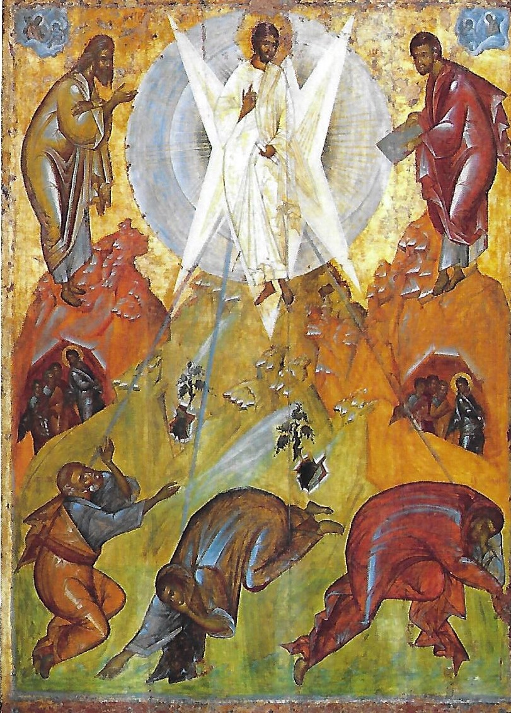

Slide 18
The Transfiguration, Creation and the Environment
In recent years the Gospel account of the transfiguration has been one of the New Testament passages frequently drawn on to assist Christian theological reflection on the environment. In part this is because of the tragedy that the atomic bomb at Hiroshima was dropped on August 6, traditionally kept as the Feast of the Transfiguration.
Now there are two ways to walk:
Towards the radiance of the transfigured Christ
Or the radiance of the Bomb.
Towards the radiance that descends to touch,
To heal, to restore.
Or towards the radiance that descends to defend,
To murder, and to destroy.
Towards the radiance that glorifies
Or the radiance that vaporizes.
This day I set before you life and death,
A blessing and a curse:
Choose this day whom you will serve.

Slide 19
But in reality many Christian theologians, especially in the Eastern Orthodox tradition, have long apppreciated the links between the transfiguration and the cherishing of the earth and environment. For example, Bishop Kallistos Ware:
Within the Gospel story, the Transfiguration of Christ stands out as the ecological event par excellence.
The Transfiguration reveals the Spirit-bearing potentialities of all material things.
Christ, so the event on Mount Tabor makes clear, came to save not our souls alone, but also our bodies. Moreover, we human beings are not saved from but with the world. In and through Christ – and, by virtue of Christ’s grace, in and through each one of us – the whole material creation, as Saint Paul expresses it, “will be set free from its bondage to decay and will obtain the freedom of the glory of the children of God” (Romans 8:21).We human beings, in other words, are called to continue and to extend the mystery of Christ’s Transfiguration on the mountain.

Slide 20
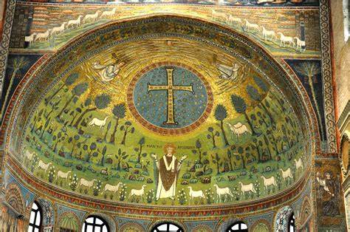

Slide 21
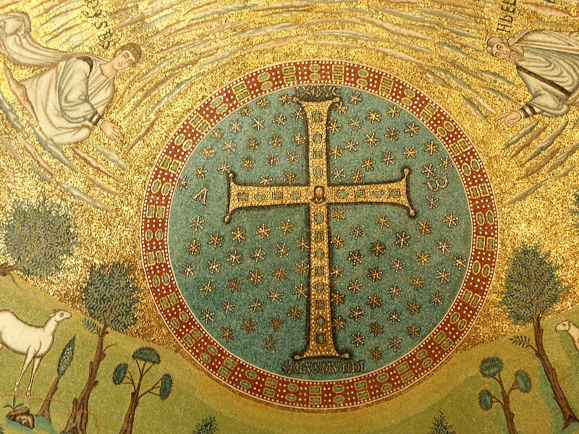
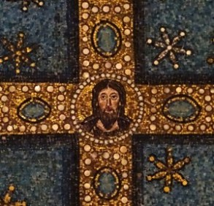
…they were speaking of his departure (exodos) which he was to accomplish at Jerusalem

Slide 22
Kallistos Ware:
… let us recall the Cross which dominates the Transfiguration mosaic in Sant’ Apollinare. What is it, we ask, that links Paradise in the past (Genesis 1-2) with Paradise in the future (Revelation 21-22)? There is but one answer: the Cross. Without cross-bearing, there can be no cosmic transfiguration. Without sacrifice and kenosis (self-emptying) after the example of Jesus Christ crucified, there can be no ecological renewal.
All this needs to be applied to our ecological work, whether for our own or for future generations. There can be no transformation of the environment without self-denial, no fundamental renewal of the cosmos without voluntary sacrifice. In Christ’s words, “Truly, truly, I tell you, unless a grain of wheat falls into the ground and dies, it remains just a single grain. But if it dies, it bears much fruit” (John 12:24). Gain comes through loss, life through death, transfiguration through cross-bearing.
“We cannot save what we do not love. There can be… no true wisdom, without love; and equally there can be no cosmic transfiguration without love.”

Slide 23
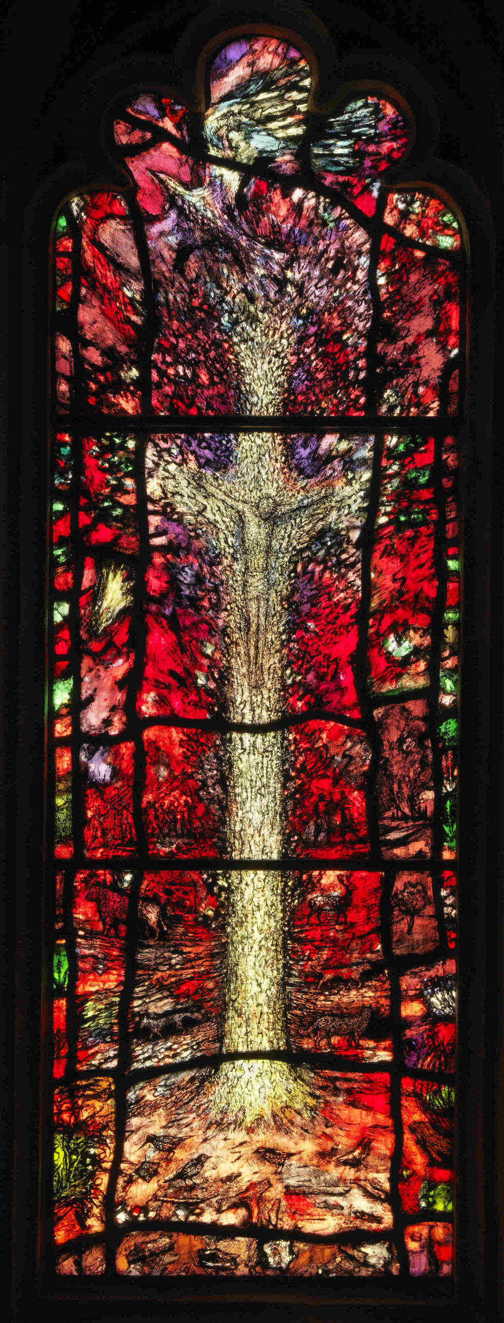
‘The Cross is a tree set on fire with invisible flame which illumineth all the world. The flame is love.’ (Thomas Traherne)
The placing of the tree in the midst of a ‘wood’ suggests that we should read the words not only in the context of the wood of the cross on Good Friday but also the trees of Gethsemane the evening before. However the way that the figure on the tree which represents the cross almost disappears into the background, gives us a sense that what the Crucifixion is about is almost the ‘dissolution of God’. It is as though the concept of God is dissolved and remade. It is as if the Cross itself – and its occupant – are being dissolved for the sake of the beauty of the whole of creation, for its radiant life. In order to give radiance to the creation the creator accepts being at this ‘crux’ as vulnerable yet life-giving victim.

Slide 24
I see his blood upon the rose And in the stars the glory of his eyes, His body gleams amid eternal snows, His tears fall from the skies. I see his face in every flower; The thunder and the singing of the birds Are but his voice—and carven by his power Rocks are his written words. All pathways by his feet are worn, His strong heart stirs the ever-beating sea, His crown of thorns is twined with every thorn, His cross is every tree. (Joseph Mary Plunkett)

Slide 25
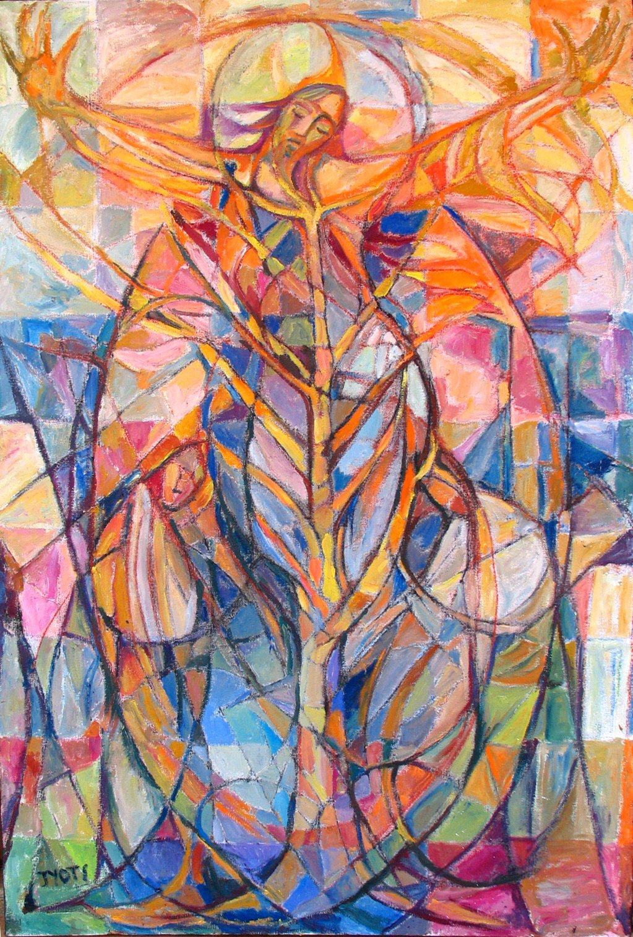
The Gospel of John
‘A new Genesis’
The Word became flesh and dwelt (skn) with us, and we have seen his glory, glory as of the only Son from the Father (1.14)
For God so loved the world that he gave his only Son (3.16)
The hour has come for the Son of Man to be glorified. Very truly I tell you, unless a grain of wheat falls into the earth and dies, it remains just a single grain, but if it dies, it bears much fruit. (12.23-24)
Pilate said to them, ‘Here is the man’. (19.5)
Supposing him to be the gardener… (20.15)

Slide 26
“We cannot save what we do not love. There can be… no true wisdom, without love; and equally there can be no cosmic transfiguration without love.” (Kallistos Ware)
What might ‘love’ mean when we are reflecting on humanity’s responsibility for creation and the environment?

Slide 27
Loving Creator,
You have made all living things to delight in you
and to be your delight;
and you have made humanity for yourself
With hearts that are restless till they rest in you.
Male and female you made us as your glory,
To reflect and fulfil your longings for our world.
In the life of Jesus Christ,
You offered us an image and vision of yourself,
A pattern of your generous and profligate love.
Enable us to glimpse how love and sacrifice
Have been woven into the fabric of this universe,
And are at the heart of our relationship with you.
Give us passion to care for
and protect the beauty of your creation,
and to share in the transfiguring of this our cherished world.
In the name of Christ. Amen

